Slide 1
Company Profile
Company Overview

Slide 2
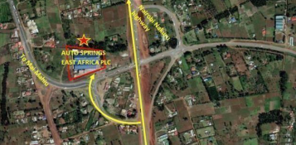
Company Overview Background
Auto Springs East Africa PLC (ASEAP) is One of the Kenya’s largest Automotive parts manufacturer for Original Equipment Manufacturers (OEMs) and After Sale Market in East and Central Africa.
Auto Springs was established in the year 1979 and has been producing a wide range of products for motor vehicles and motorcycles specifically leaf springs, nuts and bolts (centre bolts, U bolts, wheel studs, shackle pins etc.) and wiring harnesses for various models of commercial vehicles and motorcycles. In addition to the above, the company is also involved in a wide range of modification of springs to make them suitable for Kenyan roads.
The factory is located in Limuru near the interchange of Kamandura Mai Mahiu Narok road and Eldoret Malaba road.

Slide 3
Company Overview
Partnerships
Staff
Ascent Rift Valley Fund (ARVF), Ascent Rift Valley Fund (ARVF), a leading SME Private Equity Fund investor acquired a significant stake in the company in 2018 and invested additional capital into product expansion and factory improvements. Partnership with Ascent gave strength and ability to better serve the quality and service demands of our clients.
Auto springs has highly experienced staff force. The production staff ranges from engineers, machine operators, welders, fabricators, painters, quality control staff and general workers among others.
The administration staff ranges from accountants, marketers, environment, health and safety specialist among others
Collaborations
Quality Assurance
Each of our products meets and exceeds the KEBS (Kenya Bureau of standards) standards. The Company is also IATF 16949:2016 certified giving quality assurance to our customers. We are also known for the unsurpassed speed of delivery and after-sales service.
Auto springs has established a collaboration with Supreme springs from South Africa in order to enhance quality of products as well as technology exchange. This is inline with the concept of Kaizen that advocates for continuous improvement.

Slide 4
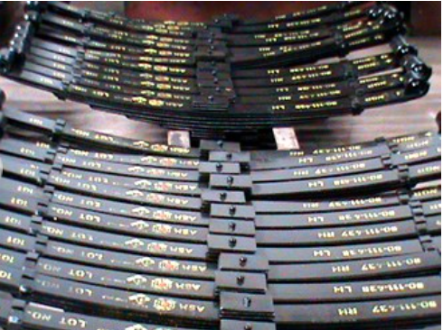
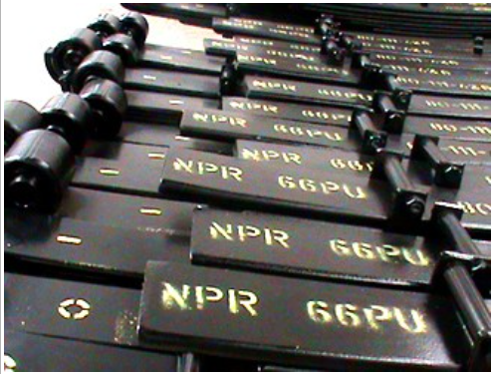
Company Overview
Products - Springs
The company produces an average of 150 tonnes of springs per month supplied to customers in Kenya, Uganda, Tanzania, Democratic Republic of Congo and Zambia.
The Multi-leaf springs are uniquely designed to provide support, stability and safety to a vehicle and are superlative among the vehicle springs.
The multi-leaf springs come in variable width whilst maintaining its thickness. The springs consist of a main leaf and helper leaves, which carry proportional amount of load, to provide support to the vehicle.
The factory has a dedicated workforce modern and automated machinery to ensure quality and efficiency in production to meet the market demand
Isuzu NPR 3.6 Rear Assembly
Leaf Springs

Slide 5
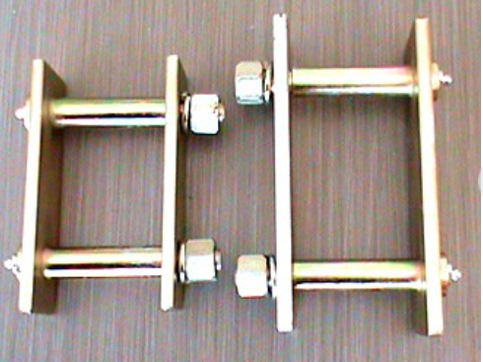
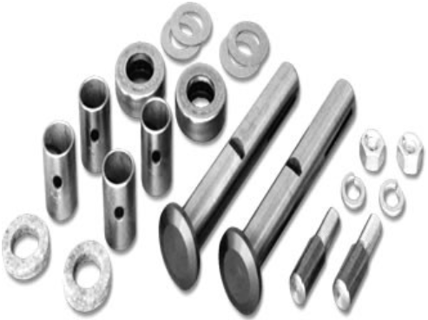
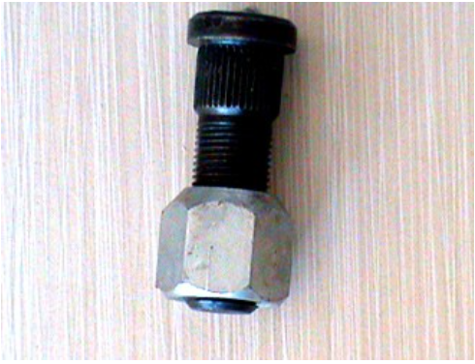
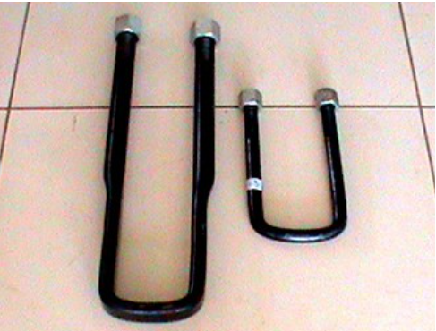
Company Overview
Products - Bolts and Nuts
Schakle Pin & Assembly
King Pins
With close to four decades of experience in manufacturing conventional leaf suspensions ASEAP has forayed into producing other products such as U-Bolts, Centre Bolts and Bushes to provide the complete package to our customers
Auto Spring EA provides any kind of U-bolt as per a customer’s drawings/specifications.
Wheel Studs
U - Bolts
Washers, Collar Nuts & Brackets

Slide 6
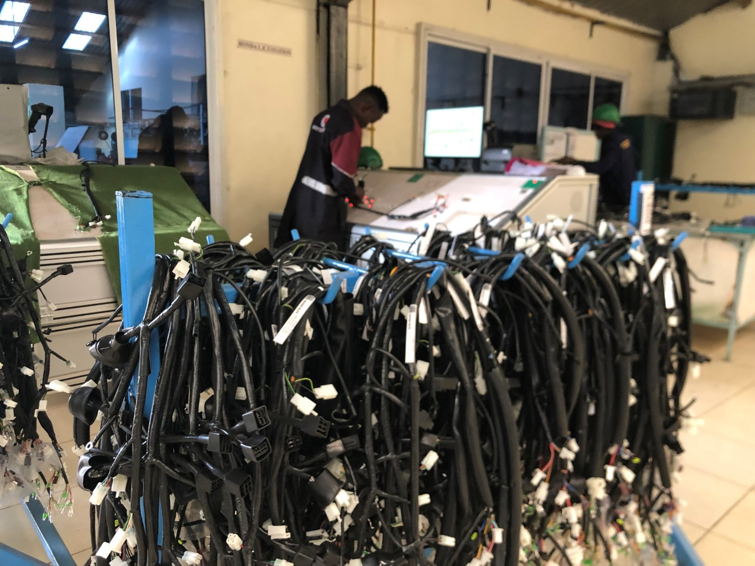
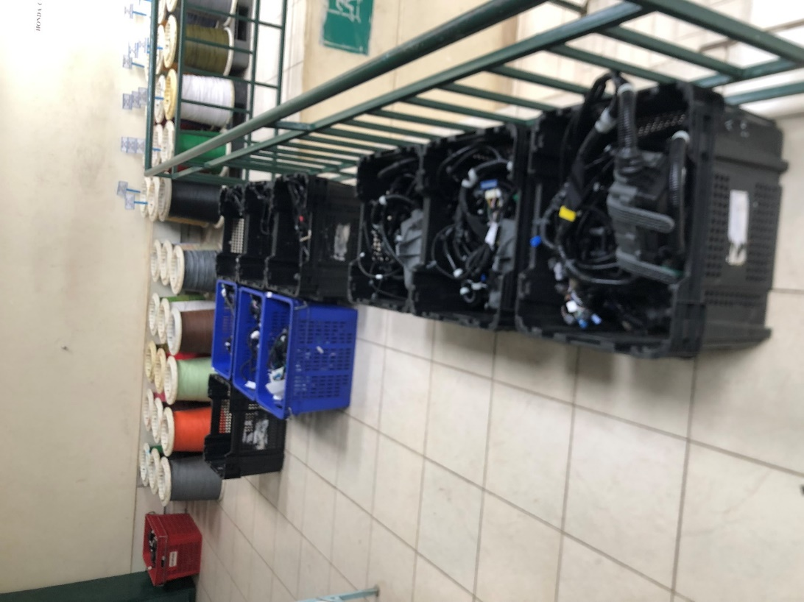
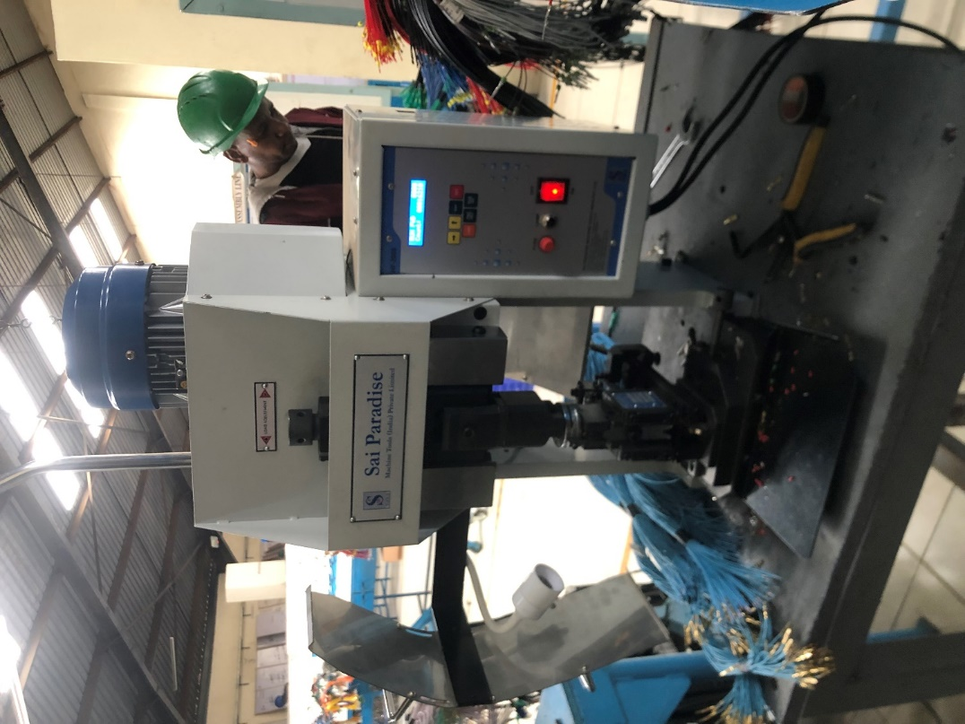
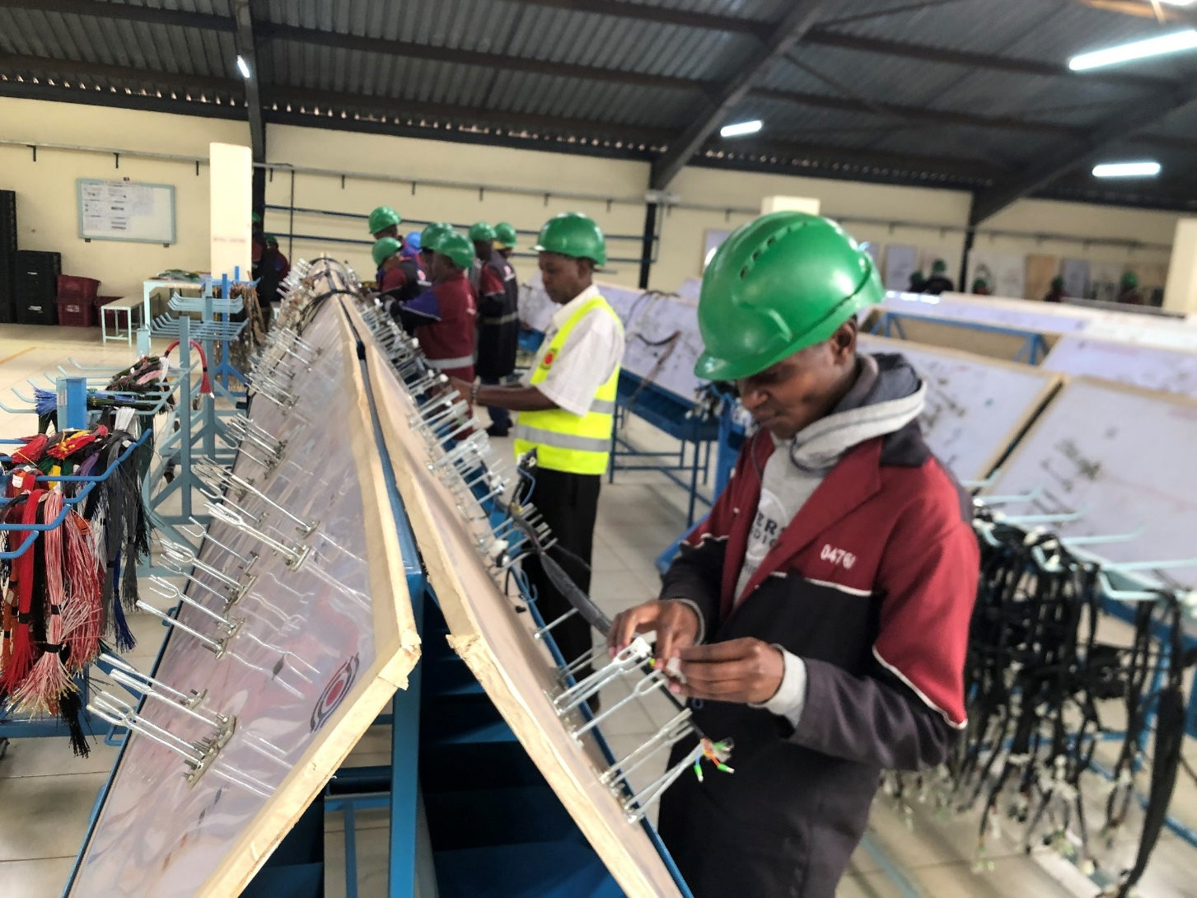
Company Overview
Products – Wiring Harness
The company supplies wiring harness to Isuzu East Africa for a wide range of trucks and buses. In addition, the company supplies Mobius Motors Limited, RSA Kenya limited among others.
The company has developed harnesses for motorcycles supplying to Honda Motorcycle Limited, Auto Industries (Bajaj), Car and General (TVS), Roam Electrical Limited, Makindu Motors Limited (Skygo), Abson Motors Limited, BMG Holdings Limited among others.
The company has recently improved its production line by automation of parts of the production line. New generation machinery such as the crimp cross section testing machine, crimping machines, PVC Welding machines and harness testing machines have been acquired to improve the quality of our wiring harness.
Harnesses Ready for Delivery
Harness Testing
Harness Assembly
Terminal Crimping Machine

Slide 7
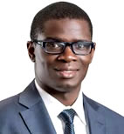
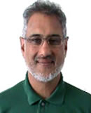
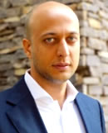
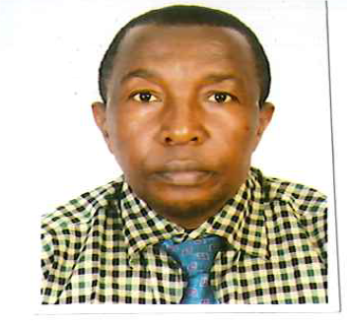
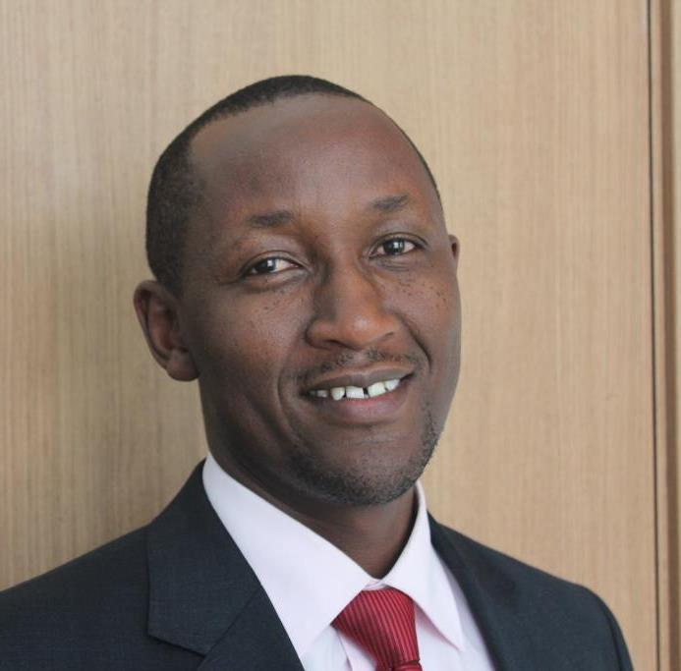
Company Overview Board of Directors
David Owino is a partner at Ascent Capital Advisory Services LLP. He has worked in the private equity sector in East Africa for 16 years. He has previously managed in excess of $150 million at Centum, the leading East African investment holding company.
He holds a BSc. (Business Administration) from USIU – A and an MBA from Strathmore Business School.
Salil Patel was the Company's CEO until his retirement in 31st March 2020. He has been instrumental in taking the company through tumultuous changes caused by wholesale and unchecked importation. He has been in the company for 26 years. He planned and executed the building of the new factory in Limuru. He has also successfully built up a number of manufacturing concerns in East Africa. He holds a degree in Economics from the University of Miami USA..
David Owino
Director
Salil Patel
Bilal Vaiani is a private equity professional at sub-Saharan private equity fund Ethos Private Equity.
He also holds directorships at Rafiki Group of Companies, a family owned group with investments in real estate, trading and manufacturing. Bilal Vaiani has a Bachelors in Aerospace Engineering, Masters in Finance and is a qualified accountant (ACA).
Board Chairman
Wilfred Wangari is a seasoned engineer with close to forty years’ experience in diverse industries in operations, maintenance, design and general management. He has twenty years in the motor vehicle industry and ten years in the energy sector. He is currently the general manager of power systems division of Simba Corp. He is a consultant in energy audits, efficiency improvement and total quality management (TQM) He has a Masters Degree in International Business Administration and a Bachelor of Science Degree in Engineering.
Bilal Vaiani
Director
He Joined the Company in January 2018 as Commercial Director and CFO until 1st April 2020 when he was appointed as the CEO. His work experience ranges from Financial Management, Business Development and General Administration for over 20 years. His previous appointments include Head of Business Development at Questworks Limited (Engineering, procurement and construction firm), University Secretary at Strathmore University, Group Finance Manager at Kenya Wine Agencies Limited and Internal Audit Manager at Longhorn Publishers Limited.
He holds an MBA and a Bachelor of Commerce (Accounting option) both from the University of Nairobi. He is a certified Public Accountant of Kenya (CPAK 1999) and a holder of Certified Public Secretary (CPS) final certificate.
Wilfred Wangari
Director
Nephat Njengwa
Executive Director & CEO

Slide 8
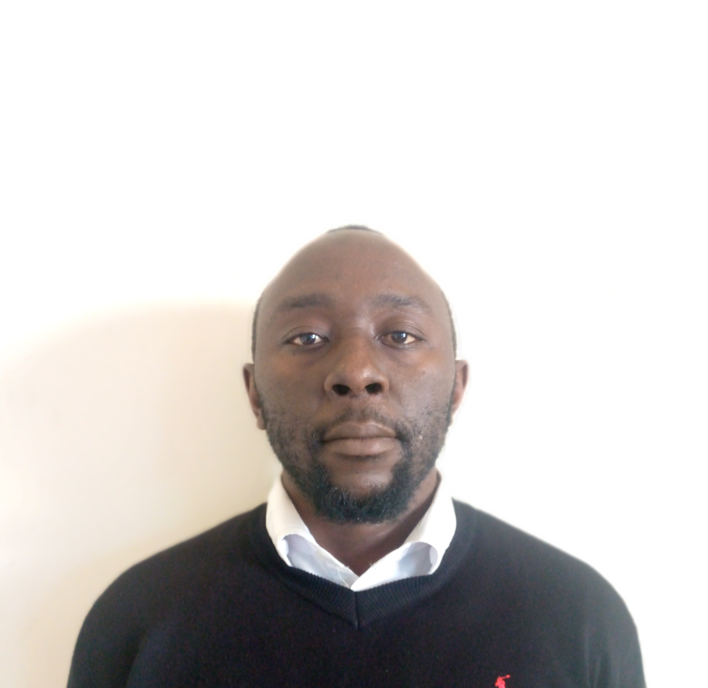
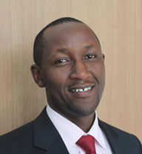
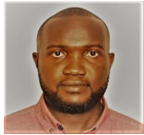
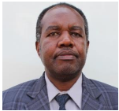
Company Overview Management Team
He Joined the company in January 2018 as Commercial Director and CFO until 1st April 2020 when he was appointed as the CEO. His work experience ranges from Financial Management, Business Development and General Administration for over 20 years. His previous appointments include Head of Business Development at Questworks Limited (Engineering, procurement and construction firm), University Secretary at Strathmore University, Group Finance Manager at Kenya Wine Agencies Limited and Internal Audit Manager at Longhorn Publishers Limited.
He holds an MBA and a Bachelor of Commerce (Accounting option) both from the University of Nairobi. He is a certified Public Accountant of Kenya (CPAK 1999) and a holder of Certified Public Secretary (CPS) final certificate.
He joined the company in May 2023 as a financial Accountant and currently serving as acting Finance & Administration Manager. He is a graduate from Moi University with Bachelors of Economics and also a CPA- (K) finalist. He has over 6 years of experience in Finance and Accounting in NGO &Manufacturing sector.
Nephat Njengwa
Eric Wanjala
Executive Director & CEO
Finance & Administration Manager
He joined the company in September 2016 as the Quality Engineer and later Production engineer until 2020 when he was appointed as the HOD – Springs Department a post he held until 20th July 2022 when he was appointed as the Factory Manager.
Kennedy is a Mechanical Engineering graduate of Jomo Kenyatta University of Agriculture and Technology (JKUAT)and a registered member with Engineering Board of Kenya (EBK). He has over 7 years experience in manufacturing
He joined the company in March 1989 as Production Supervisor. He was appointed Head of department for Wiring Harness in 2014. He has over 30 years of work experience in various fields such as Harness Development, Quality Control, Harness Production and Procurement. He holds Higher National Diploma in Electrical and Electronics from The Kenya Polytechnic currently the Technical University of Kenya
Kennedy Kadimah
Allan Kisia
Factory Manager
HOD Wiring Department

Slide 9
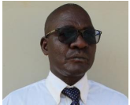
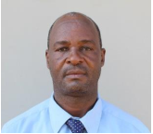
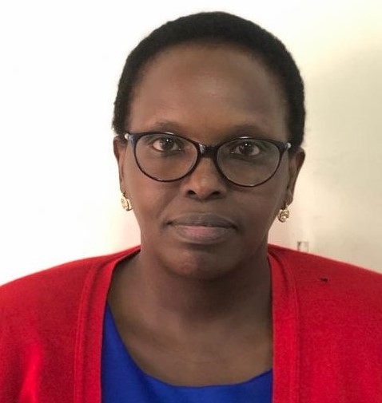
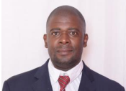
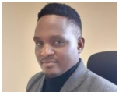
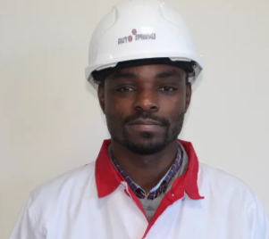
Company Overview Management
He Joined the company in January 1984 as Production Supervisor, spring department, logistics department and later Head of Department
His work experience ranges from Sheet metal work, Quality Control and Die fabrication for close to 40 years
He joined the company in 1981 as a Technician and rose up the ranks to his current position.
He has over 40 years of work experience 20 being in diverse maintenance operations such as Electrical systems, Manufacturing machines and equipment.
She Joined the company in August 2023 as H R Manager. She holds a Diploma in Human Resources Management and a graduate from Mt.Kenya University with Bachelors of Business management Human Resources management . She is a certified Human Resource professional CHRP-K and a Certified Human Resource Auditor.
She has over 10 years of experience in HR in Agricultural Sector. She is a full member of IHRM ,and holds a practicing license.
Shadrack Nyandiko
Henry Muli
Fancy Cherono Rono
HOD Maintenance Department
Human Resource Manager
HOD Engineering Department
Joined the company 2022 bringing a wealth of knowledge and experience having worked with OML Africa Logistics Ltd, Tullow Oil, Lafarge Holcim, Bureau Veritas and former Jet Link express. Holds a BSC in Mechanical Engineering and a Diploma in Aeronautical Engineering. EBK registered and trained in Quality Mgt systems (ISO 9001 2015 & IATF 16949:2016
He joined the company in may 2021. He has more than 17 years of experience in various fields manufacturing. Previously, held various technical roles with Mars Wrigley -Dubai including production plant operations, Quality control, Food safety, plant maintenance, Waste management, Health, safety and environmental management.
He joined the company in 2016. He has 10 years of work experience in sales and marketing and other fields.
He holds a BSc. in Applied Statistics with Computing He has held other positions in IT related fields at Red Cross (Kenya), Dune Trekker (Uganda)
Shadrack Musa
Robert Wabuge
Stephen Wambua
Quality & Process Engineer
Quality Improvement Coordinator & Ag ESG Mgr
Sales & Marketing Manager

Slide 10
Company Overview Key Customers
Auto Engineering
Electric Motorcycle
Motorcycle Assembler
Auto Engineering
Auto Engineering
Assembly Plant
Bajaj Motorcycle Assembler
Agricultural
Auto Engineering
Auto Engineering
Agriculture
Electric Motorcycle
Electric Motorcycle
TVS Motorcycle
Motorcycle Assembler
Logistics

